Slide 1
RCE FRONT END DEMO
Technologies
REACT
TYPESCRIPT (NODEJS)
REDUX-THUNK

Slide 2
REACT
A JavaScript library for building user interfaces
Benefits
Easy
Performance
Reusable components
Single page application (very hard to do with just javascripts and html)

Slide 3
Redux-Thunk
popular and open-source Javascript library
management measure states of the application
acts as a middleware between UI and backend API
Returns async dispatch function for store data

Slide 4
Typescript
Superset of Javascript. It is Javascript plus a type system.
Typescript vs Javascript
Pros | Cons
Strong typed language | extra step — transpiling
Rich IDE support | One more JavaScript to learn
Fast refactoring
Predictability for debugging and writing

Slide 5
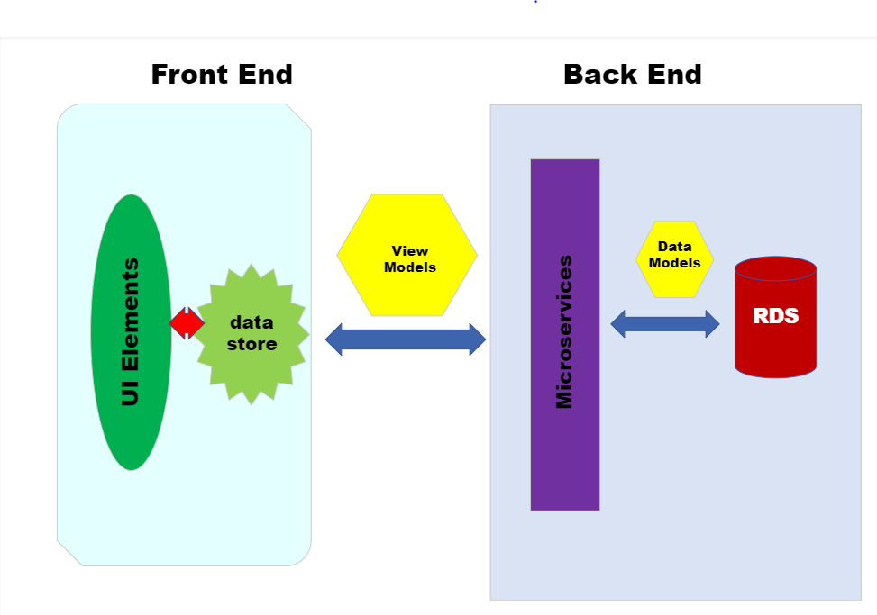
Application Structure Diagram

Slide 6
Demo
Focus on functions with minimum styles and layout
View models for application in a list
Pull the list of view models from backend
Demonstrate the functions of Add, Delete, View and Edit
A Sprint boot backend is developed to work with it

